Slide 1





Sailability in Queensland
Sailing for people with disability

Slide 2


Sailability
Across the Globe
  Organisations formed in the late 1970s in the UK to provide sailing for people with disability
  Now active in some 23 countries
  Over 350 clubs globally
  70 clubs in Australia

Slide 3

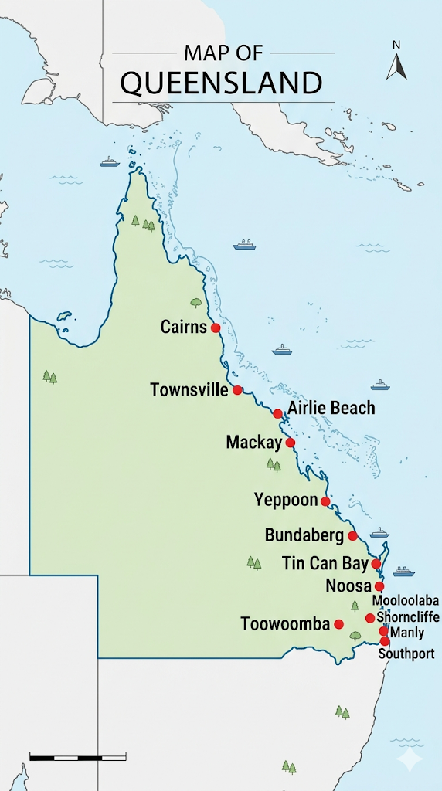
Sailability in Queensland
  Sailability Queensland supports 13 affiliated clubs.
  Each week, 580 sailor-clients take to the water
  Over 500 dedicated volunteers
  A fleet of 89 Access '303' dinghies, 3 yachts, 4 SV 14 dinghies, 5 pontoon boats, 4 Hobie Cats, and
  Ensuring every sailor has the right vessel for their needs, and
  A range of support boats to enhance safety on the water

Slide 4

Volunteering with your local Sailability club lets you ...
  Help others and your community
  Learn and share skills across a range of activities
  Be welcomed into a caring, respecting environment
  Know you are valuable
  Join a friendly, inclusive team and make connections
  Make a real difference every time you come

Slide 5

Our Sailors/Clients benefit ...
Promotes Personal Growth:
Unlocks sensory gateways
Increased control over illness and functioning
Non-clinical environment reduces stigma
Empowerment through real-life challenges
Leaving disability on shore
Research & Evidence:
• Studies show measurable benefits from adaptive sailing
• Improved physical and mental wellbeing
• Greater confidence and independence
• A sense of achievement and belonging
• Sailing truly is for everyone

Slide 6

Community Partners & Donations
Sailability connects with
Disability community and special schools
Government
Australian Sailing
Service clubs & local businesses
Supporters & donors help us
  Reach more sailor-clients, and
  Grow our Sailability community across Queensland
Your donation
  Puts smiles on faces, and
  Covers vital expenses

Slide 7
Sailability in Queensland and Australian Sailing
Sailability Queensland complements Australian Sailing
  SQ Acts as the specialized state-level coordinator that enables the national body's inclusivity goals to be realised on the water in Queensland
  Australian Sailing sets the national framework and represents the sport broadly
  In concert with the framework, SQ coordinates insurances, risk management (based on AS plans), and volunteer support networks required for disability sailing.

Slide 8

Volunteer
an invitation to you
  Join a friendly, welcoming and caring team
  Come when you are able – every visit makes a difference
  Know you are helping to make sailing accessible for people with disability
  No experience necessary - learn and share skills
  Your volunteering will become part of something special

Slide 9


Get on Board today
So, whether you support Sailability in kind, monetarily or as a volunteer, your contribution will make a difference!

